Slide 1

AI-Powered Financial Advisor System
A Comprehensive Solution for Financial Planning and Investment Management
Presented by: Your Team Name
Date: December 2023

Slide 2

Introduction & Overview
Purpose
Key Features
To engineer a robust, AI-driven financial advisor system specifically designed for automated portfolio creation, dynamic risk profiling, and advanced investment simulations.
•
Portfolio recommendations tailored to individual risk profiles.
•
Real-time Monte Carlo simulations for investment scenarios.
The system aims to democratize financial advice by providing personalized, data-backed insights comparable to human wealth managers.
•
SEBI-compliant guidance via a RAG subsystem.
•
Interactive Chatbot interface for seamless user engagement.

Slide 3

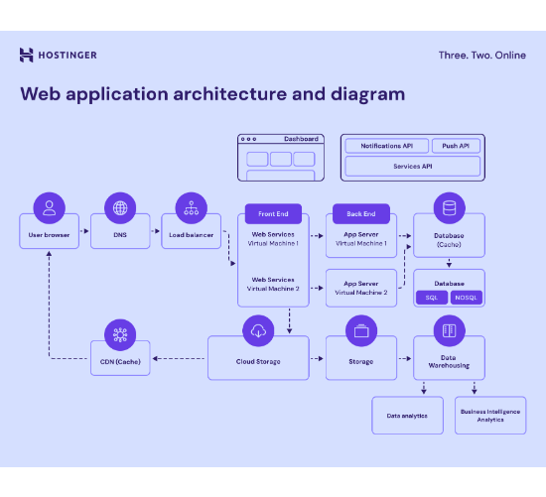
System Architecture
The system is built on a modular architecture to ensure scalability and performance:
Frontend: Streamlit UI for an intuitive user experience.
Backend: FastAPI orchestration layer handling API requests.
Core Intelligence: Azure GPT model managing tool execution.
Memory Layer: Redis and SQLite for state management.
Tooling: Specialized engines for Risk, Portfolio, and RAG.

Slide 4








Technology Stack
Frontend
Backend
Storage
AI Model
Streamlit
FastAPI
Redis & FAISS
Azure OpenAI
Interactive Web Interface
High-performance REST API
Session & Vector DB
GPT-4 Intelligence

Slide 5

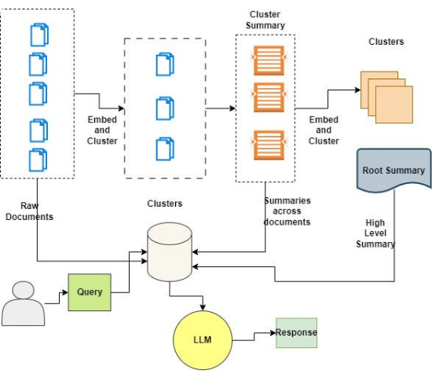
RAG (Regulatory Assisted Guidance)
Purpose: Ensures all financial advice is grounded in current SEBI guidelines and regulatory frameworks.
Components
FAISS Indexing: High-speed vector retrieval of regulatory documents.
Smart Chunking: Splitting legal texts into semantic segments for precise context matching.
Optimization: Enhanced semantic search and topic-aware retrieval logic.

Slide 6

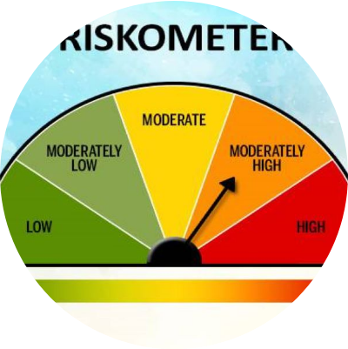
Risk Profiling Engine
Assessing Investor Tolerance
The engine acts as the foundational layer for all portfolio recommendations.
Inputs: Analyzes age, income stability, knowledge, and liquidity needs.
Process: Categorizes users into Conservative, Moderate, or Aggressive profiles using Azure GPT.
Impact: Directly dictates the asset allocation strategy (Equity vs. Debt).

Slide 7
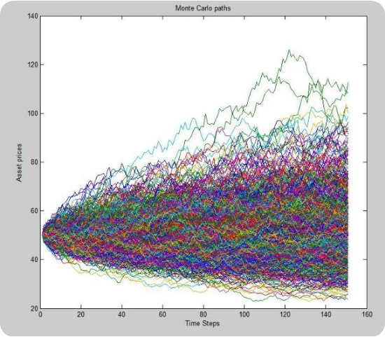
Portfolio & Simulation Engine
Portfolio Building
Constructs optimized asset allocations (Equity, Debt, Gold) strictly based on the user's risk profile.
Monte Carlo Simulation
Runs thousands of market scenarios to project future wealth.
Outputs: Best/Worst case scenarios, expected returns, and goal achievement probability.

Slide 8
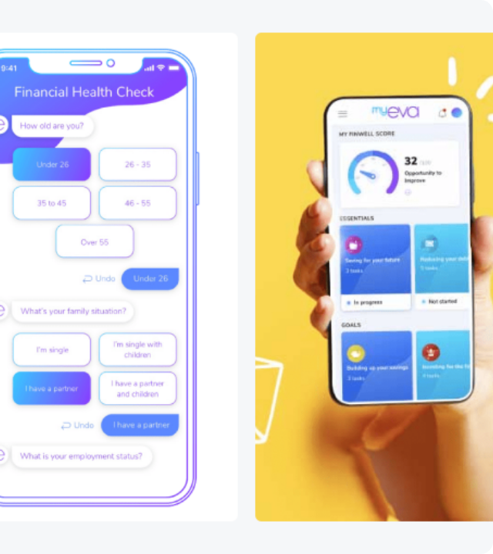
Chatbot Interface
Interactive Guidance: A conversational interface that acts as the primary touchpoint for users.
Workflow:
User inputs financial goals and SIP details.
Chatbot triggers backend tools for profiling.
Delivers structured advice and charts.
Integration: Seamlessly connects to the Risk and Portfolio engines in real-time.

Slide 9







System Evaluation
Latency
RAG Accuracy
Simulation
Blue-Rouge
Response time measurement to ensure real-time interaction capabilities.
Precision and Recall scores for regulatory document retrieval.
Accuracy of Monte Carlo projections against historical data.
Measures semantic alignment of generated advice with expert text.

Slide 10
Challenges & Solutions
Challenge: Incorrect Risk Profiling
Solution: Fine-tuned the profiling logic and implemented strict input validation layers.
Challenge: RAG Retrieval Performance
Solution: Enhanced chunking strategies and adopted advanced semantic search embeddings.
Challenge: Chatbot Interaction Flow
Solution: Integrated tool-based decision making for context-aware responses.

Slide 11





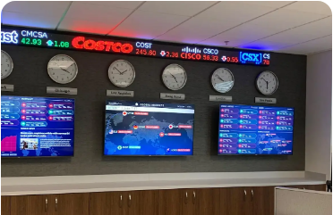
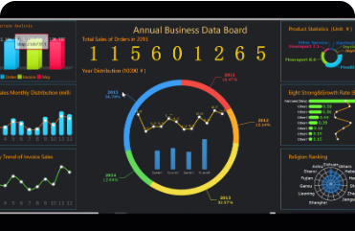
Future Roadmap
Expanded Document Base
Real-Time Market Data
Advanced Analytics

Slide 12

Conclusion
We have successfully developed an AI-driven financial advisor that empowers users with reliable, automated guidance.
Personalized: Tailored advice via robust profiling.
Reliable: Backend-powered simulations.
Seamless: Intuitive chatbot interface.
Transforming complex financial planning into an accessible conversation.

Slide 13
Questions?
Thank you for your attention.

Slide 14






Image Sources
https://www.hostinger.com/tutorials/wp-content/uploads/sites/2/2025/05/Web-application-architecture-diagram.png
Source: www.hostinger.com
https://miro.medium.com/v2/resize:fit:587/1*apjVlAqa28cvkbQZjGdNkQ.jpeg
Source: medium.com
https://www.fisdom.com/wp-content/uploads/2021/03/riskometer.jpg
Source: www.fisdom.com
https://i.imgur.com/Uu7DVPn.jpg
Source: analytica.com
https://www.tidio.com/wp-content/uploads/financial-chatbots-700x510.png
Source: www.tidio.com
https://static.vecteezy.com/system/resources/previews/071/433/696/non_2x/digital-compliance-check-with-magnifying-glass-icon-representing-regulation-validation-contract-approval-policy-governance-corporate-transparency-legal-documentation-and-secure-audit-workflow-free-photo.jpg
Source: www.vecteezy.com

Slide 15



Image Sources
https://www.risedisplay.com/wp-content/uploads/2025/04/financial-hero-min.webp
Source: www.risedisplay.com
http://www.finereport.com/en/wp-content/themes/blogs/images/2019061102A.gif
Source: www.finereport.com
https://divcomplatform.s3.amazonaws.com/www.iofm.com/images/crop.WebinarFeatured_77.jpg.large-1024x600.1024x600.jpg
Source: www.iofm.com

